Slide 1
Error Mitigation
25 November 2025

Slide 2
Structure
A reminder on noise and errors.
  Kraus Operators
  Types of noise
Error mitigation
  General statements
  Specific techniques
    ZNE
    CDR
    PEC

Slide 3
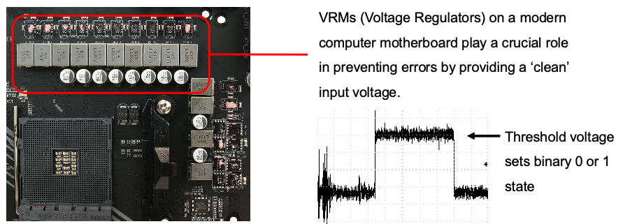
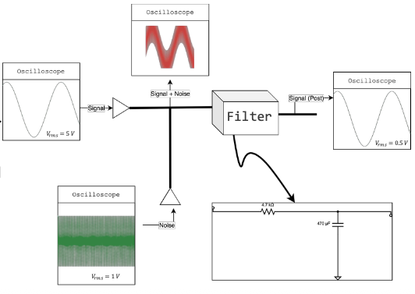
Noise is everpresent, and so is mitigation
VRMs (Voltage Regulators)
Notes:
So, what does ‘clean’ here mean?
From a simplified point of view, the
VRMs contain low-pass filters that
mitigate the errors on a hardware level.
In this example I have 400Hz ‘noise’
through a low-pass filter with the actual
signal being 40Hz. Notice that the
output is recovered to be ~ 40Hz.

Slide 4
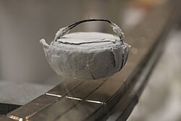
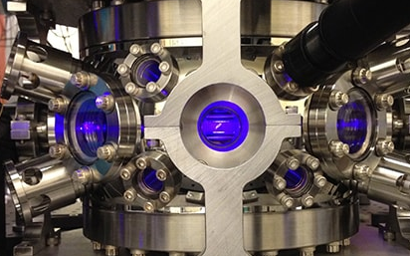
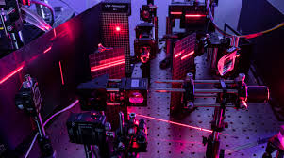
Quantum computers are much more sensitive
A lot of classical techniuques are used in the signal generation
Each hardware platform has its own properties
Superconducting:
Fast gates, scalable due to established semiconductor manufacturing methogs
Quantum state collpases easily, must be kept in a cool, dry place away from sunlight.
Trapped Ion/Neutral atoms:
Very stable qubits with long coherence times and high gate fidelities
Very slow gates and requires many lasers
Photonic
Room temperature
Weak interactions between photons (when aided by some nonlinear media) makes it hard to make 2 qubit gates.

Slide 5
The origins of errors
Heat
External or environmental radiation (can cause unintended absorption or emission of photons)
Interactions between qubits
Bad qubit control
        What do you think is the system most susceptible to heat?

Slide 6
But first! The Kraus representation
It is just a method to represent quantum channels, which are
Linear E(αρ1 + βp ) = αE(ρ) + βE(p)
Hermetically sealed ρ = ρ† implies E(ρ) = E(ρ)†
Preserves positivity ρ ≥ 0 implies E(ρ) ≥ 0.
Trace preserving tr(E(ρ)) = tr (ρ)
Most maps of this kind are referred to as TPCP (trace preserving, completely positive) maps.
The Kraus operator is just a operator-sum representation. This representation is not unique, but there are some canonical ways to represent the errors.
Notes:
Hermetically sealed usually means that Hermeticity is preserved

Slide 7
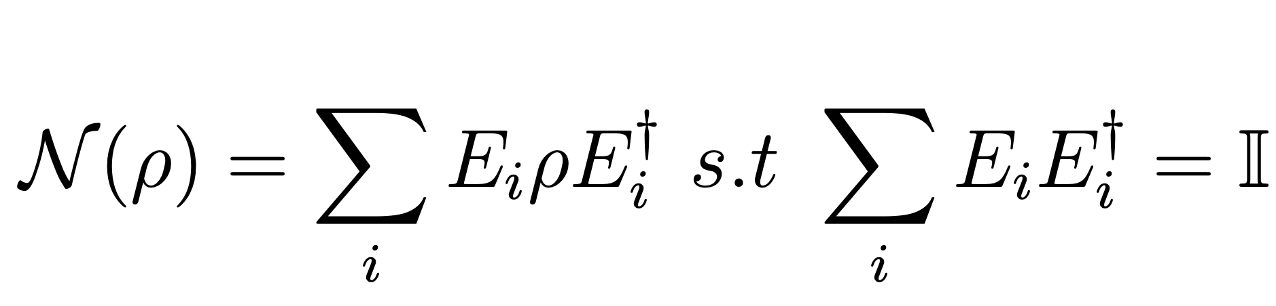
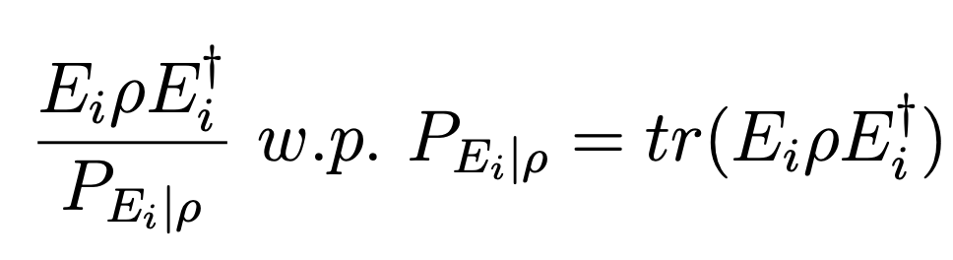
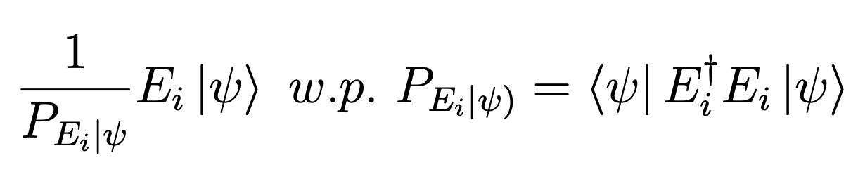
Santa Kraus
Now, these noise channels are written as
Each E_{i} can be thought of as representing a specific error on the state, and the channel being the mixture of all these errors
Do this for a pure state!

Slide 8
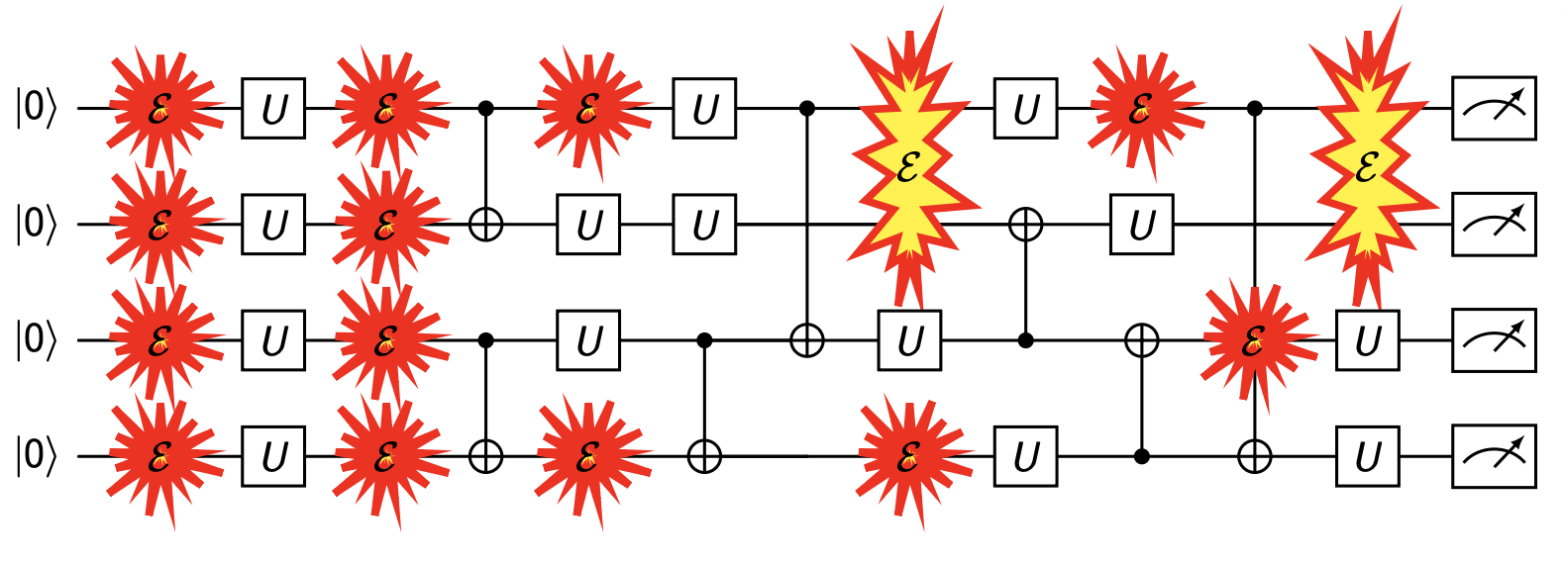
How you can think of the nosie acting on a circuit
Fully simulating noise requires density matrix simulations which scale as
(2^{n})² instead of the statevector simulation’s 2^{n} scaling. Surprisngly, a quantum computer can exactly simulate a noisy quatum computer, but not a statevector simulation! Quantum advantage has actually already been reached since the first large quantum computer.

Slide 9

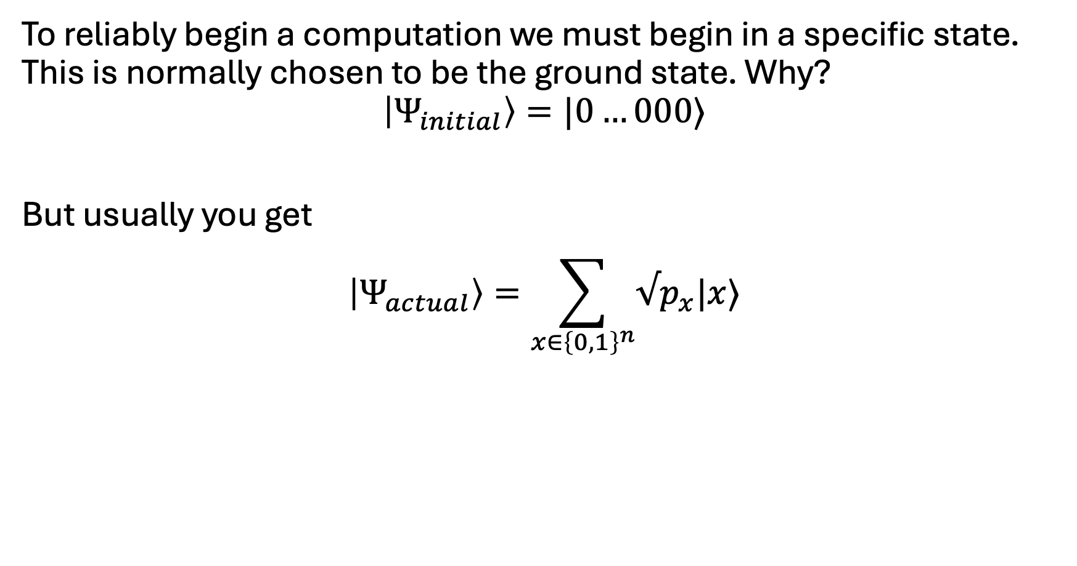
The first error – state preparation
To reliably begin a computation we must begin in a specific state. This is normally chosen to be the ground state. Why?
$$\left|Ψ_{initial}\right\rangle =|0…000⟩$$
But usually you get
$$\left|Ψ_{actual}\right\rangle =\sum_{x∈{\left\{0,1\right\}}^{n}}{√p_{x}|x⟩}$$

Slide 10
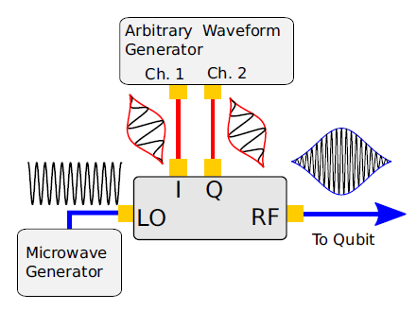
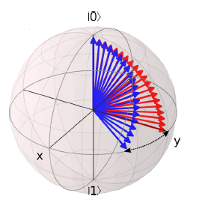
Noise/Errors
Unitary (coherent) $α\left|0\right\rangle +β\left|1\right\rangle →^{U}α^{′}\left|0\right\rangle +β^{′}e^{1\left(φ+δ\right)}$

Slide 11

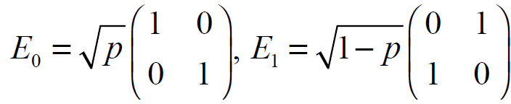
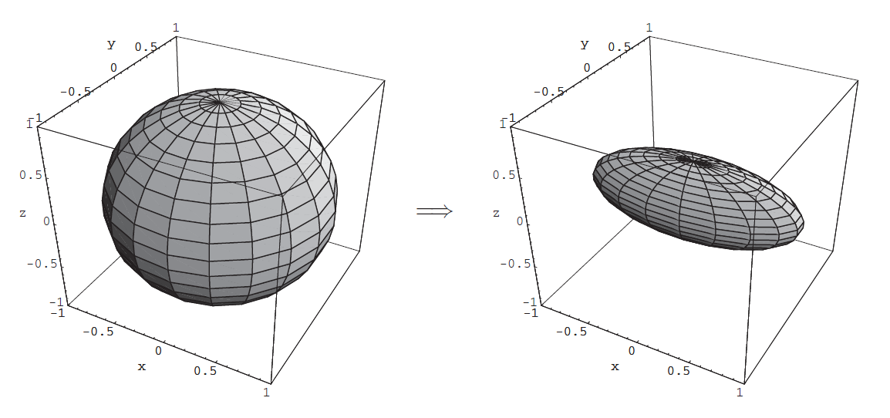
Coherent Errors
The error channels are generally studied via Kraus operators
Bit Flip
Notes:
Contraction is determined by p, 1-2p in this case

Slide 12

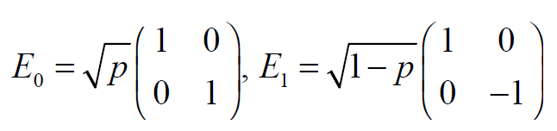
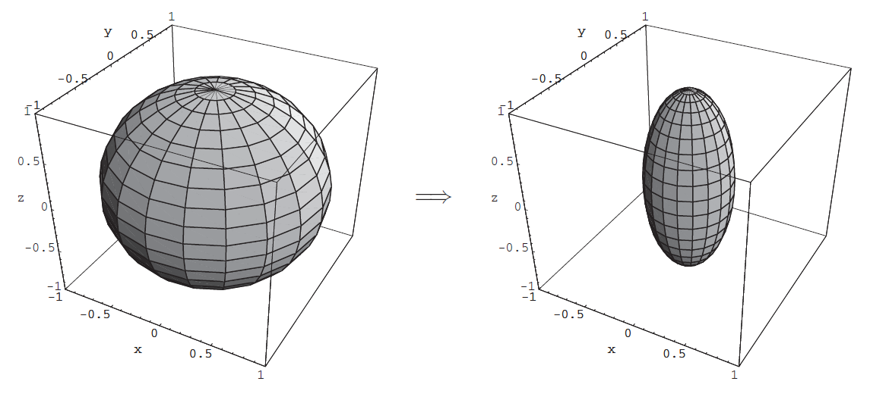
Coherent Errors
Phase Flip

Slide 13
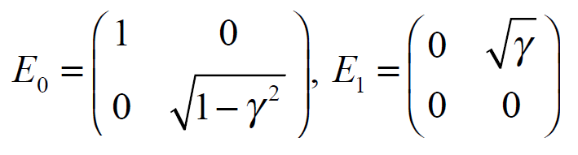
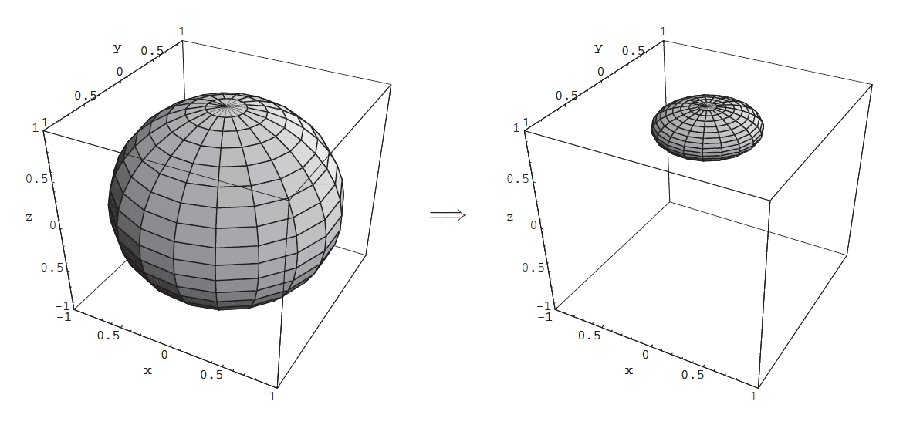
Incoherent Errors
Amplitude Damping

Slide 14
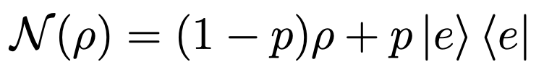
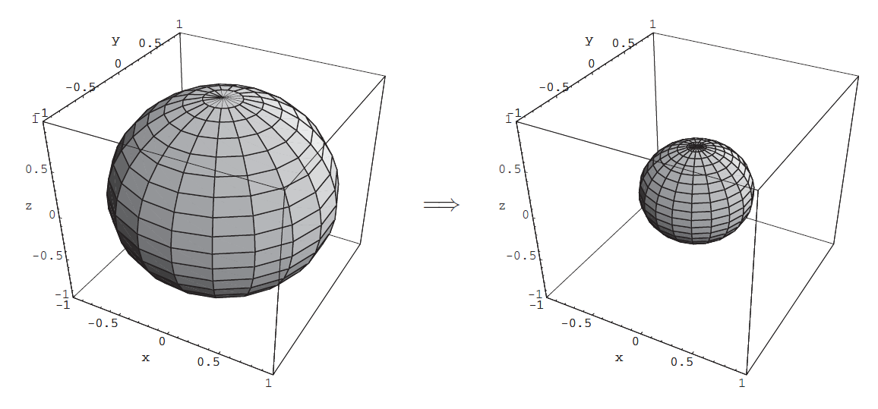
Incoherent Errors
Erasure
|e> is a non basis state.
What kind of hardware do you think has this kind of error?
Notes:
Uniform contraction of p

Slide 15
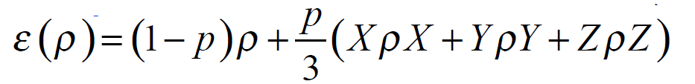
Incoherent Errors
General Pauli Channel
Depolarization
Notes:
Uniform contraction of p

Slide 16



Other important nomenclature
N qubit channels – both independent and dependent
A channel is independent if
For example, take
Then we can expect ~ pxN errors
- An error channel (or Pauli string) has weight (t) which means the number of non-Identity terms in the product
An error is a t-qubit error if each component is of weight t or less
- is.a t-qubit error channel if the Kraus operators comprise of at most t-qubit errors.
Notes:
B = SUM_i B_i is a t-qubit error if weight(Bi) ≤ t for all i.

Slide 17
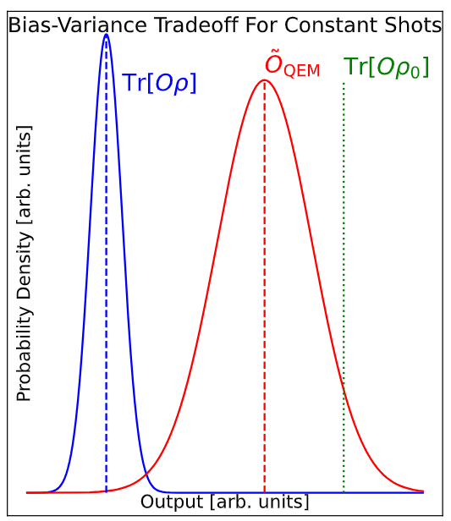
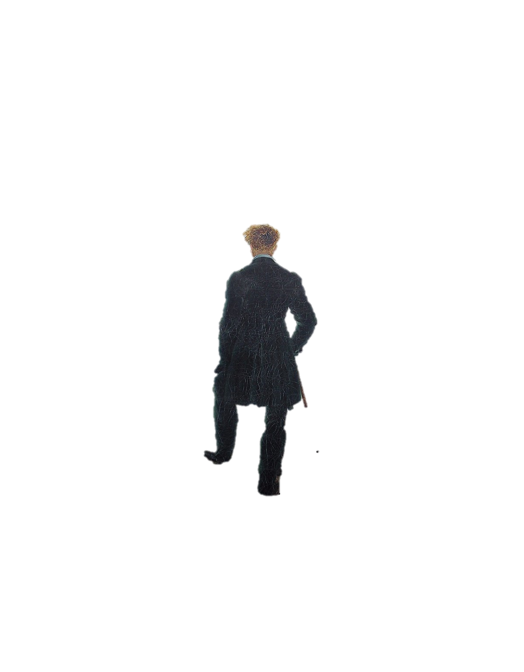

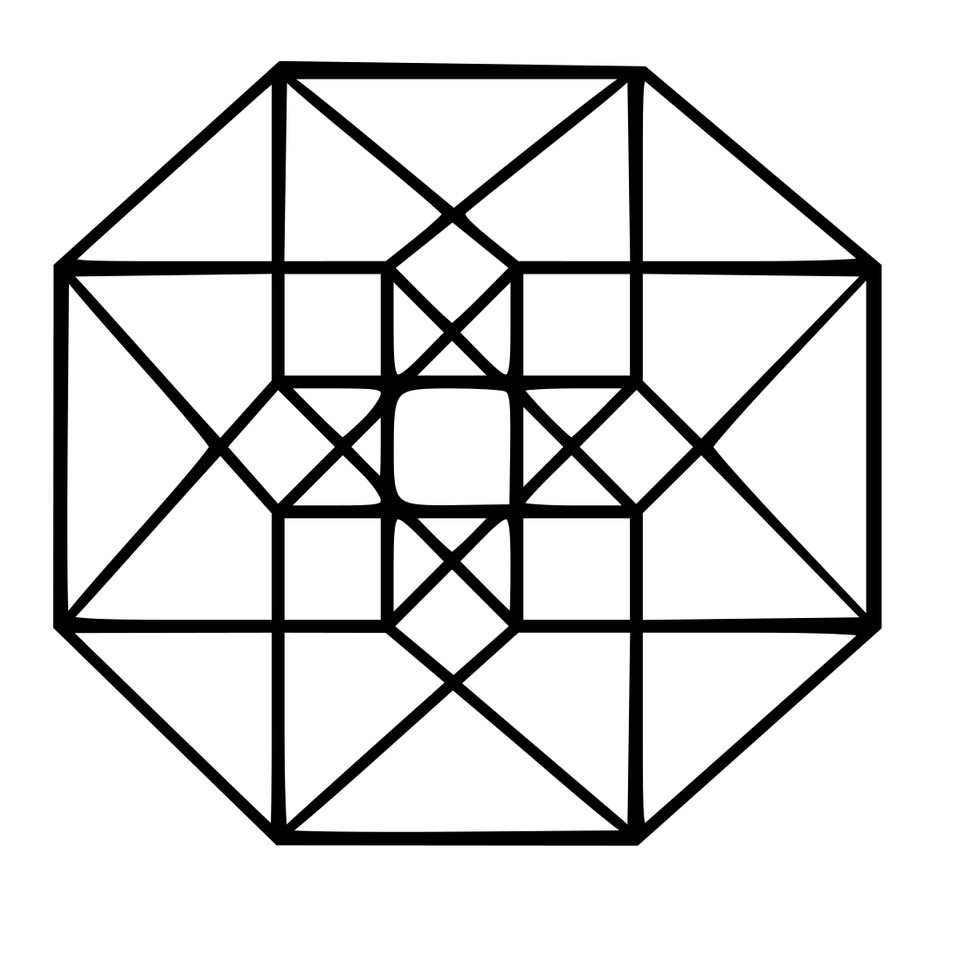

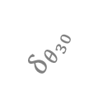

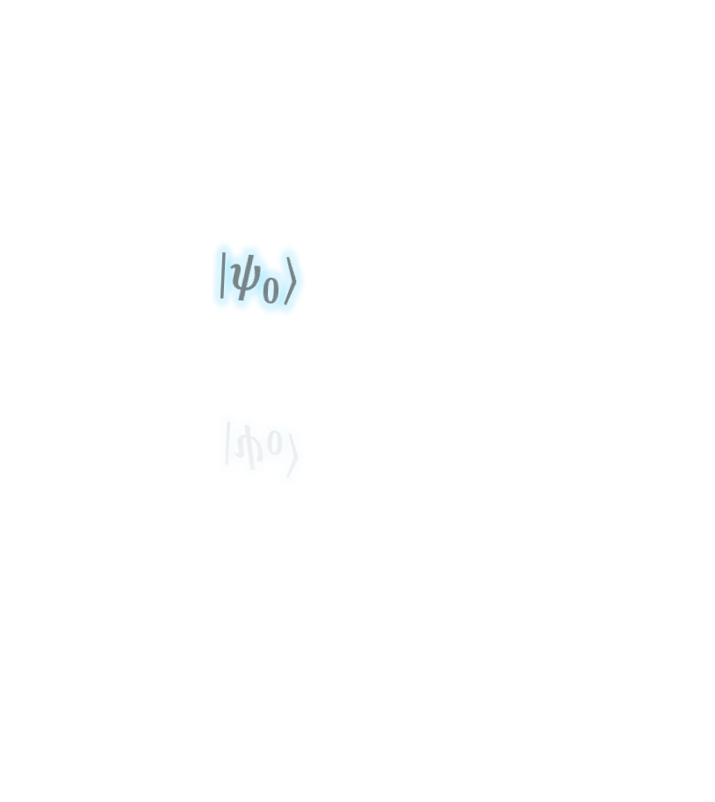
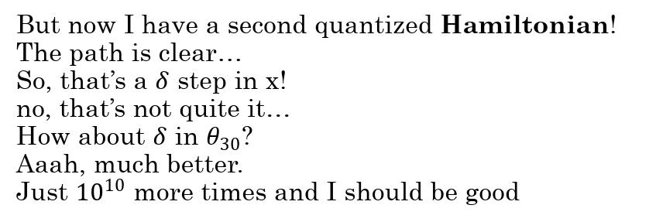
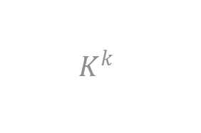


Why do we want to mitigate noise?
$$M^{m}$$
But now I have a second quantized Hamiltonian!
The path is clear…
So, that’s a $δ$ step in x!
no, that’s not quite it…
How about $δ$ in $θ_{30}$?
Aaah, much better.
Just ${10}^{10}$ more times and I should be good
$$|ψ_{0}⟩$$
$$N^{n}$$
$$K^{k}$$
Hilbert Space
$$δ_{x}$$
$$δ_{θ_{30}}$$
$$δ_{θ_{20}}$$
Notes:
More words in the slide so you don’t forget noisy etc

Slide 18

Sadly, as the parameter space and depth of an algorithm expands, the gradients become smaller, and NOISE ensures that there will be exponentially vanishing gradients.
A recent result I have discovered is that even with some qubits perfectly error corrected, barren plateaus are still a problem. Gradients become vanishingly small in what we call
“Barren Plateaus”
My Hamiltonian seems to be broken…

Slide 19
More common terms
Circuit of Interest/Primary Circuit
  The circuit we would like to approximate/run perfectly
Perfect output state
  The ideal output of our circuit ρ₀
Noisy state
  output of the primary state with a noisy process ρ
Shots
  Repetitions of circuit N
Observable of Interest
  Measurement done on the state, either noisy or pure
Sampling overhead
  Excess shots required to do error mitigation
Shot noise:
  inherent statistical noise even if no additional noise is present

Slide 20



The Essence of Error Mitigation
We aim to reduce bias
Unmitigated observable
Mitigated observable
Ideal observable
Notes:
This condition invariable increases the variance when the number of samples is constant.

Slide 21
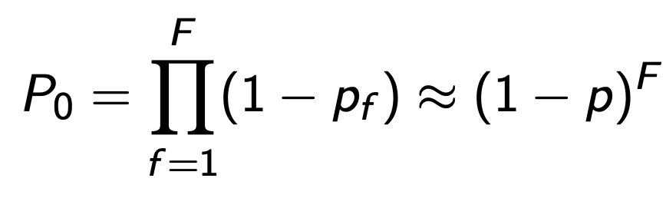
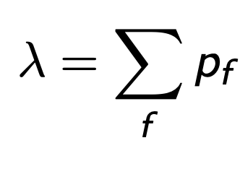
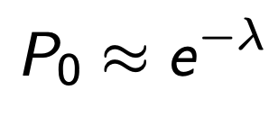
An Inevitable Wall?
All error mitigation is likely going to incur an exponential overhead with growing system size.
A simple approximation is that we have a probability p of a fault F
From which we can calculate the average number of faults
If we assume small p and many faults then we can use a
Poisson distribution to hint that there is an
exponential overhead to attaining the true state

Slide 22
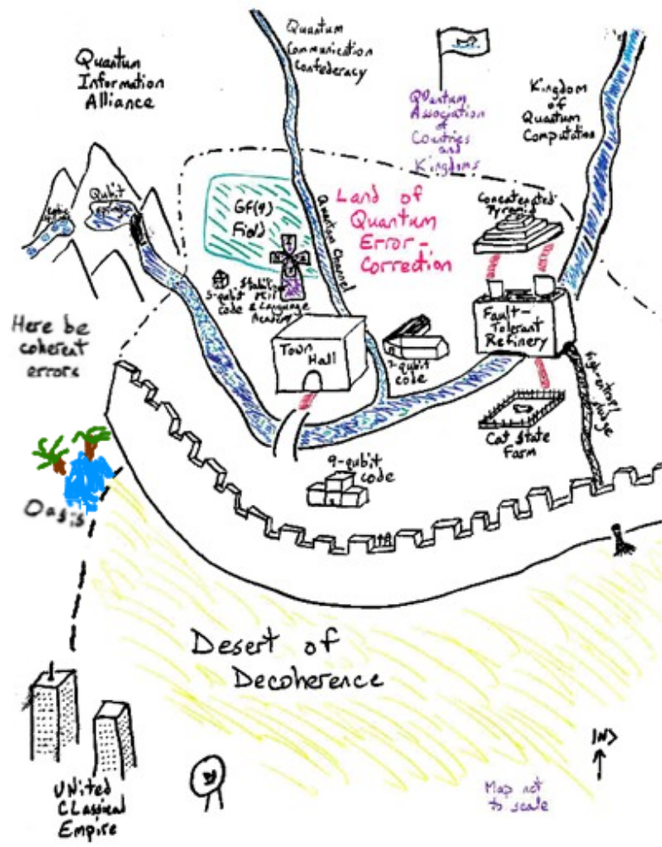
The NISQ Hope

Slide 23
General Families
Post-selection
  Exploit properties of the system (like particle number) to throw out bad samples.
Learning based
  Use a variety of approaches to learn the effect of the noise on a given experiment and use these to correct. Can be noise agnoistic or based on a model of the noise. Clifford Data Regression and Probabilistic error cancellation.
Subspace Expansion
  Use a subspace like Krylov or Laczos subspaces and estimate the observable of interest from here.
Error supression
  Technically not error mitigation, as these techinques try and alter the circuit to enhance non-noisy states before measurement. Virtual Distillation and Dynamic Decoupling are such methods.

Slide 24
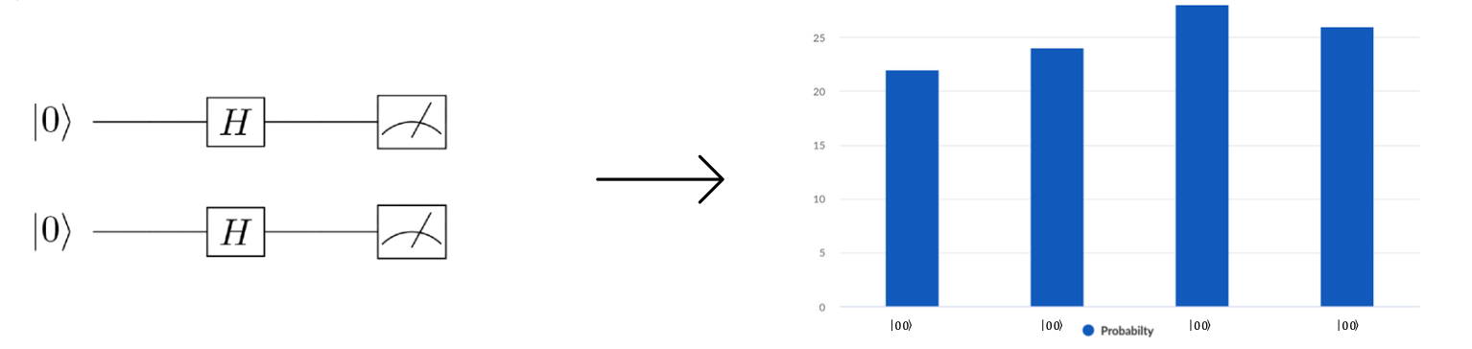
But Can We Even Rely on Measurements?
No!

Slide 25
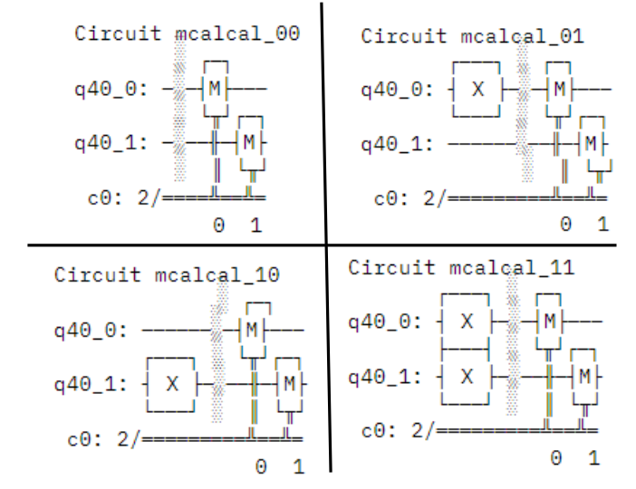
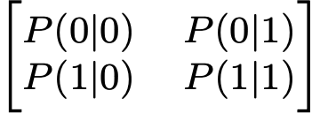
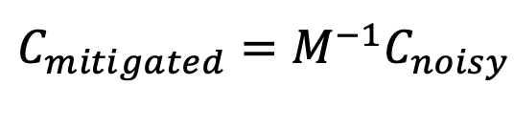
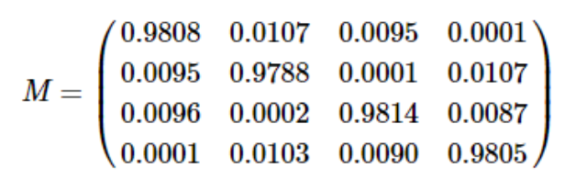
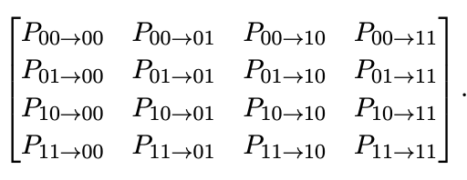
Calibration Circuits
Build a Confusion Matrix
Whose inverse mitigates the noisy measurement!

Slide 26
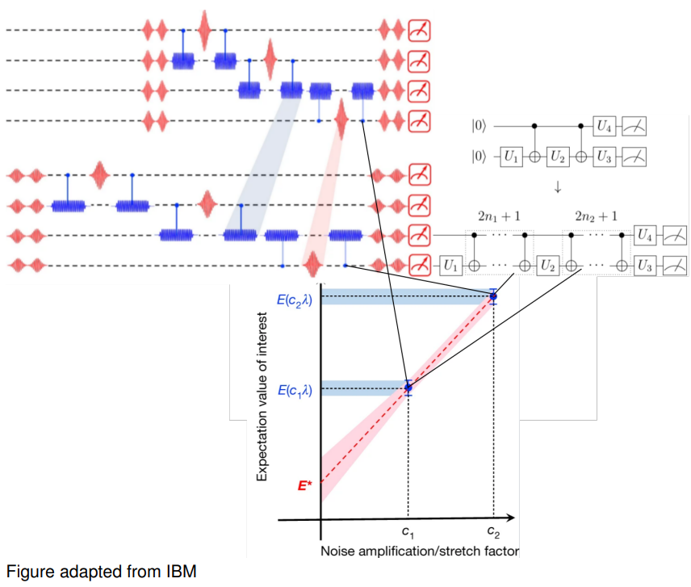
Zero Noise
Extrapolation
(ZNE)

Slide 27


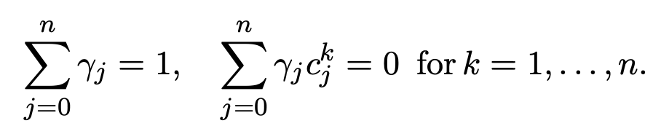
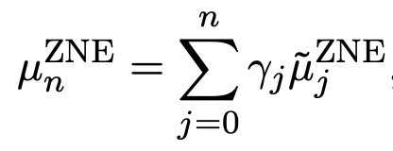
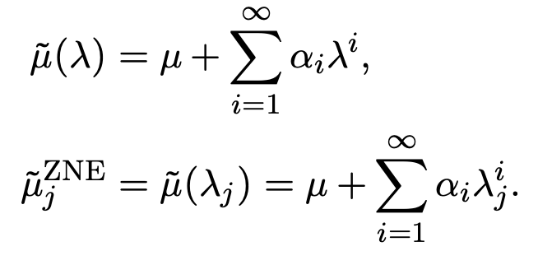
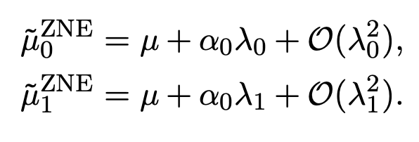
Wh0,ere c_{j} are monotonically increasing positive real numbers with integer index j=0,1,…,n. C₀ and λ₀ are 1 and the natural noise rate respectively.
We measure n+1 noisy expectation values on the real machine, creating the dataset
We then use Richardson extrapolation (but others could be used) to estimate the ‘noise free’ value as
For some expansion coefficients a_{i}
Taking just two

Slide 28
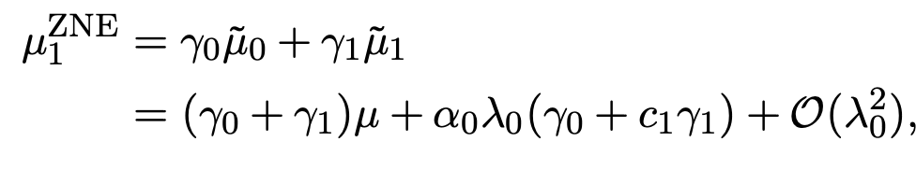
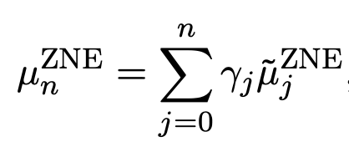
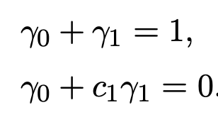
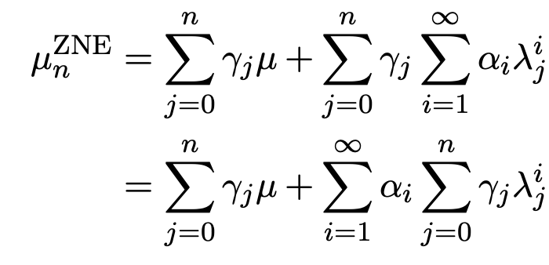
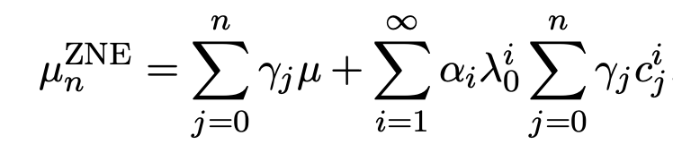
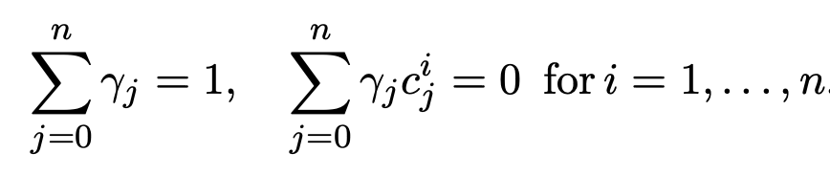
Pro memoria

Slide 29
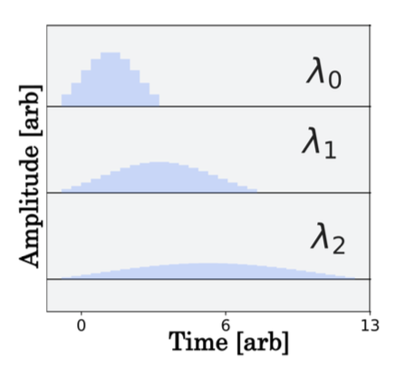

How does one increase error rates controllably?
Pulse stretching
Gate Repetition (digital ZNE)

Slide 30

Dynamic Decoupling
Here we try to increase the coherence time of qubits by acting on them with pulses equivalent to the identity
  In NMR you can think of this as the Hahn Echo

Slide 31

This is because some gates (2 qubit gates) can take 10 times as long

Slide 32




Virtual Distillation

Slide 33

Clifford Guided Data Regression (CDR)
Clifford Circuit = Efficient Circuit
https://doi.org/10.22331/q-2021-11-26-592

Slide 34






Run on quantum computer for experimental values
Stabilizer simulator for exact values
Make map to correct

Slide 35


Probabilistic Error Cancellation
We must first characterize the noise, unlike in CDR where this step is implicit in the learning
We propagate all possible combinations of small noise approximations and sample them according to some probability distribution.
Average of these runs will be a good approximation.
Simple example of the effectiive gate over many runs
Overhead if all probabilities are similar
Fault rate

Slide 36
Large dependence of the sampling on the choice of basis.
Error characterization can be approximated well (heuristically) via gate set tomography
Concept can be expanded to controllably increase noise instead of decreasing it to do a sort of ZNE for very large circuits.
Very related to Pauli Twirling where you try and change the characteristic of noise channels to be more controllable.

Slide 37
Conclusions
Error mitigation can be used to improve results on current machines
It comes with overhead, and this is generally exponential (with the number of qubits) in some resource - generally number of shots
We can correct noise on average, but not any specific error
We have explored many techniques, but new ones exist and you should scour the literature for the best (or combination of best ones) for a particular problem.

