Slide 1
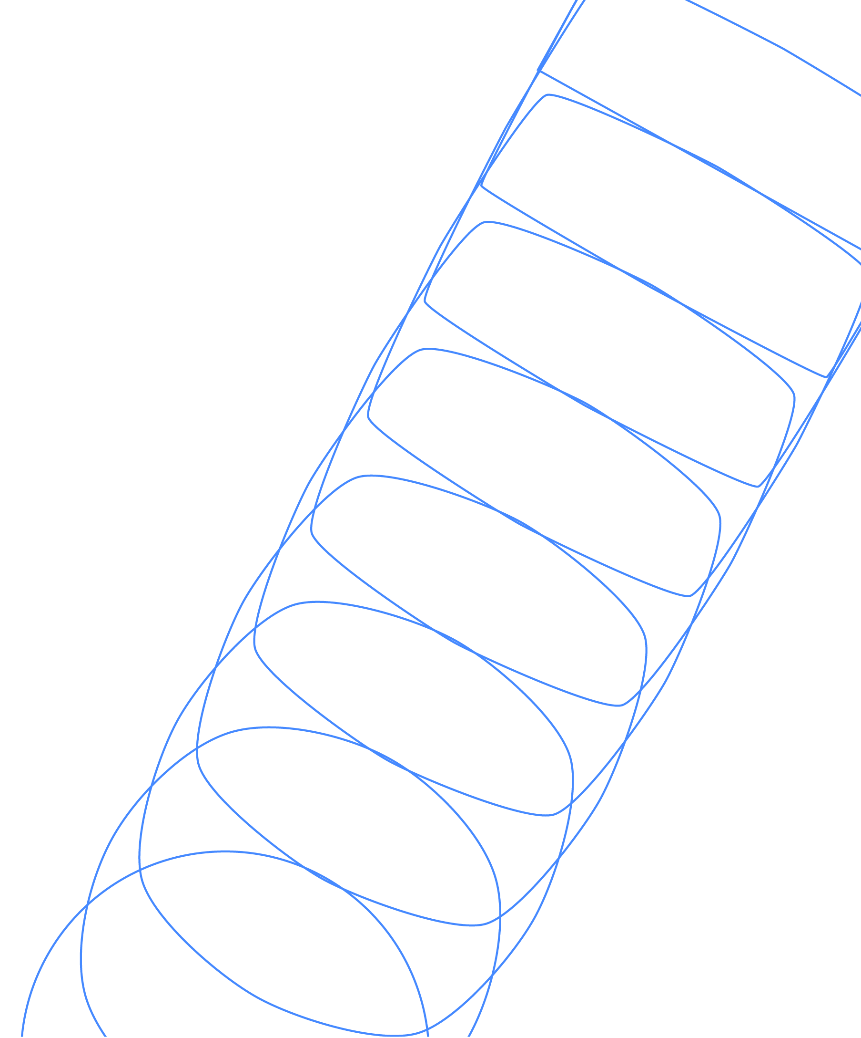
Introduction to Quantum Error Correction
James R. Wootton
IBM Quantum

Slide 2
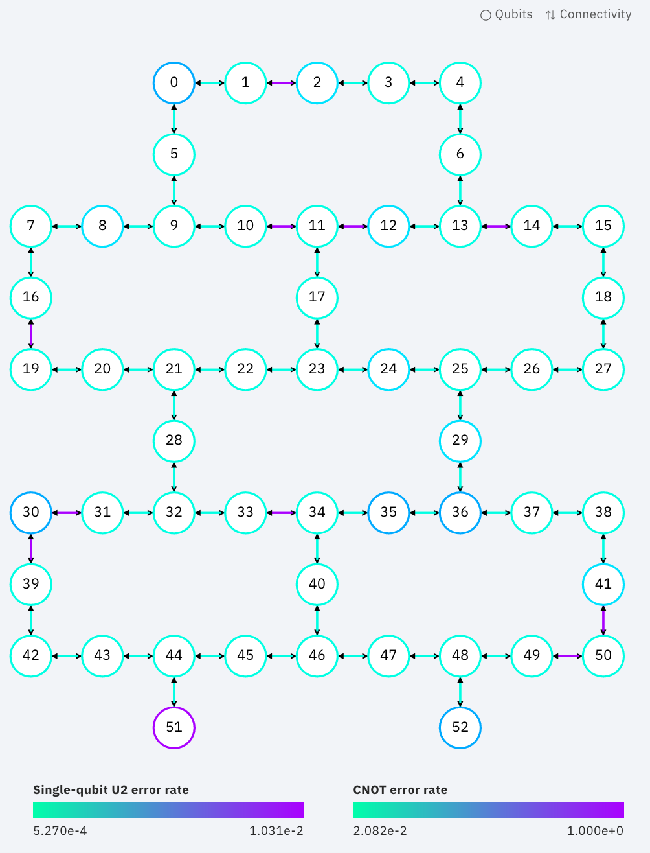
Why do we need QEC?
  Superconducting qubits don’t work exactly the way they should
    Each gate is slightly wrong
    Qubits get poked by (small) external forces
    Measurements sometimes lie
  The same is true for spin qubits, topological qubits, photonic qubits, …
  Any qubit made out of a real-life physical system will be at least a little bit rubbish

Slide 3
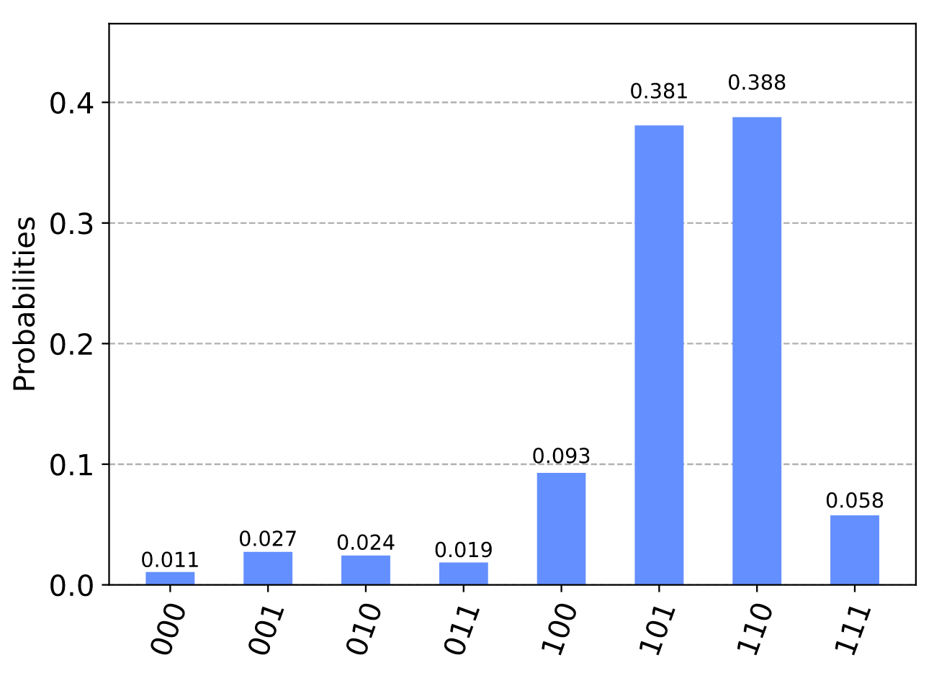
Why do we need QEC?
  Algorithms like Shor, Grover, etc assume that qubits are perfect
  Run them with imperfect physical qubits, and you’ll get nonsense out
  Instead we need qubits that are flawless incarnations of the idea of quantum information
  Such ideal qubits are called logical qubits
  We need to somehow make perfect logical qubits out of noisy physical qubits

Slide 4
Why do we need QEC?
  QEC is how we do this!
  Typically, many physical qubits are needed per logical qubit
  Using QEC in algorithms is therefore a long-term goal
  As are the algorithms that require it
  In the near term, we’ll try to make do and mitigate

Slide 5
In these lectures
  We’ll look at the ideas behind error correction (classical and quantum)
  We’ll go through specific examples
    Repetition code
    Surface code
  We’ll see the most important techniques
    Syndrome measurements
    Decoding
    Logical operations

Slide 6
What is Error Correction?
  Before we explain quantum error correction, we should think about the general idea
  A simple example: you are talking on the phone, and need to answer a question with ‘yes’ or ‘no’.
  Two important things to consider:
    How likely is it that you will be misheard?
    p = probability that ‘no’ sounds like ‘yes’, etc
    How much do you care about being misunderstood?
    P_{a} = maximum acceptable error probability

Slide 7
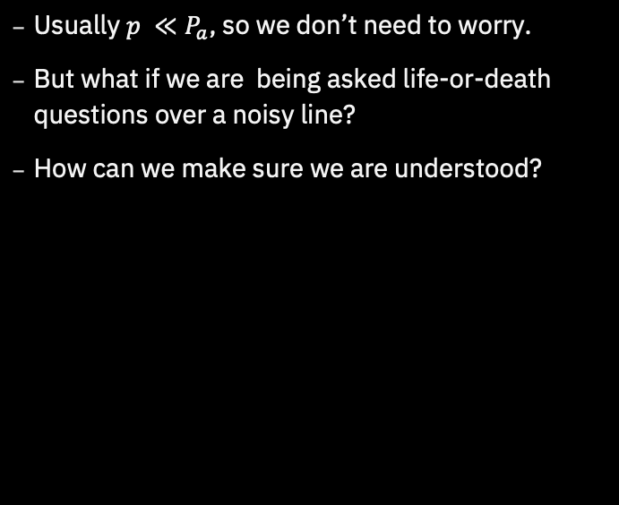
What is Error Correction?
  Usually $p ≪P_{a}$, so we don’t need to worry.
  But what if we are being asked life-or-death questions over a noisy line?
  How can we make sure we are understood?

Slide 8
The Repetition Code
  We could repeat ourselves.
  With a lot of ‘no’s, it’s obvious we mean ‘no’.
  Same for mostly ‘no’s with a few random ‘yes’s thrown in.
  With this encoding of our message, it has become tolerant to small faults

Slide 9
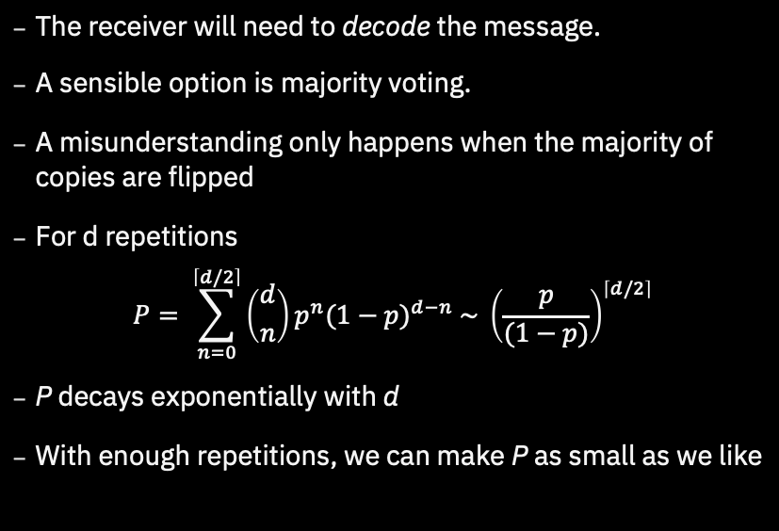
The Repetition Code
  The receiver will need to decode the message.
  A sensible option is majority voting.
  A misunderstanding only happens when the majority of copies are flipped
  For d repetitions
  $$P= \sum_{n=0}^{\left\lceil d/2\right\rceil }{\left({d \atop n}\right)p^{n}{(1−p)}^{d−n} \sim {\left(\frac{p}{(1−p)}\right)}^{\left\lceil d/2\right\rceil }}$$
  P decays exponentially with d
  With enough repetitions, we can make P as small as we like

Slide 10
Encoding and Decoding
  This example contained all the basic features of any protocol for quantum error correction.
    Input: Some information to protect.
    Encoding: Transform the information to make it easier to protect.
    Errors: Random perturbations of the encoded message.
    Decoding: Trying to deduce the input from the perturbed message

Slide 11
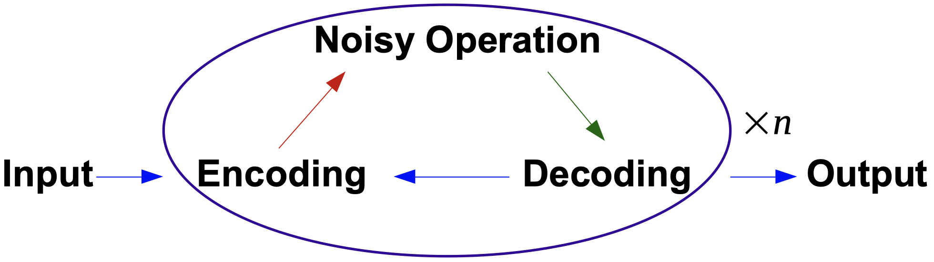
Computation
  The example we just considered was one of communication, with errors occurring during transmission.
  For computation, errors are introduced whenever we perform an operation.
  We need to correct errors as they are introduced.
  Can be done by constantly decoding and re-encoding

Slide 12
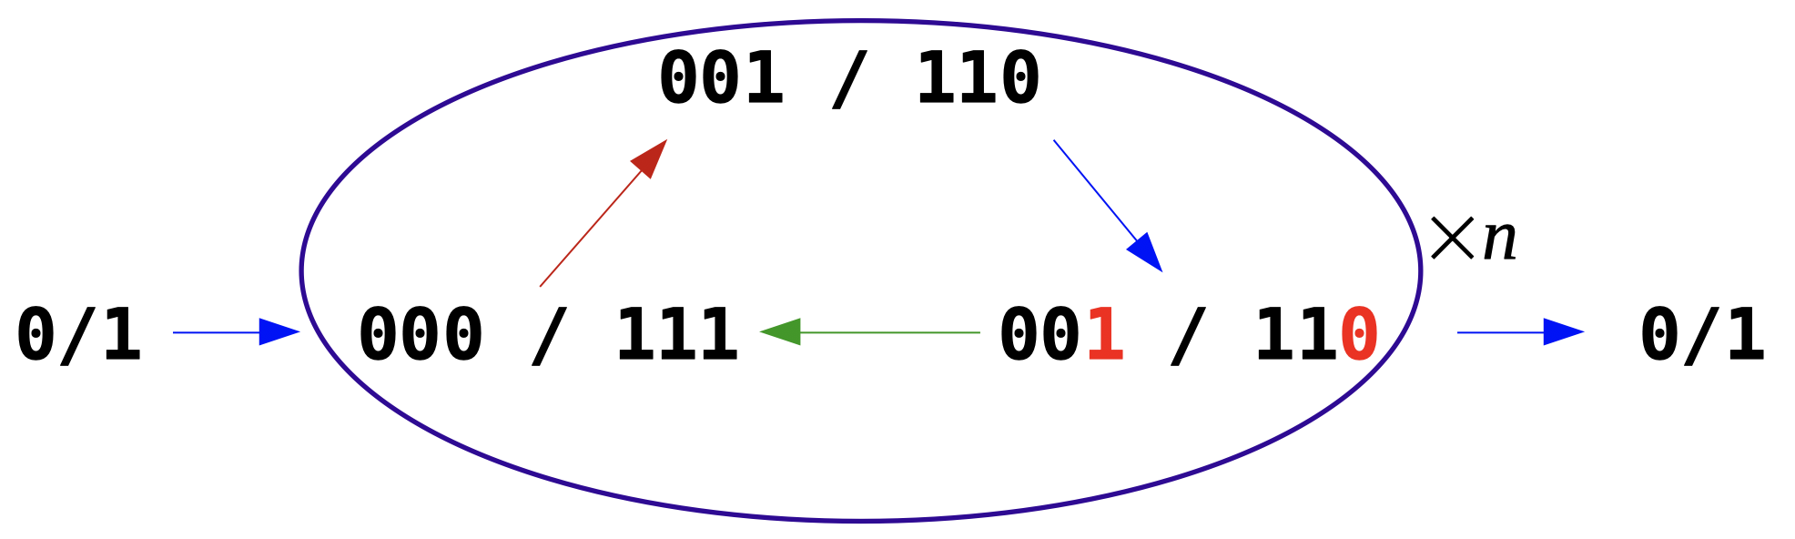
Computation
  For example, here’s a single bit using the Repetition code
  The ‘noisy operation’ here is just doing nothing (with some errors)
  Here we don’t completely decode and re-encode, but just do it enough to find and fix the errors.

Slide 13
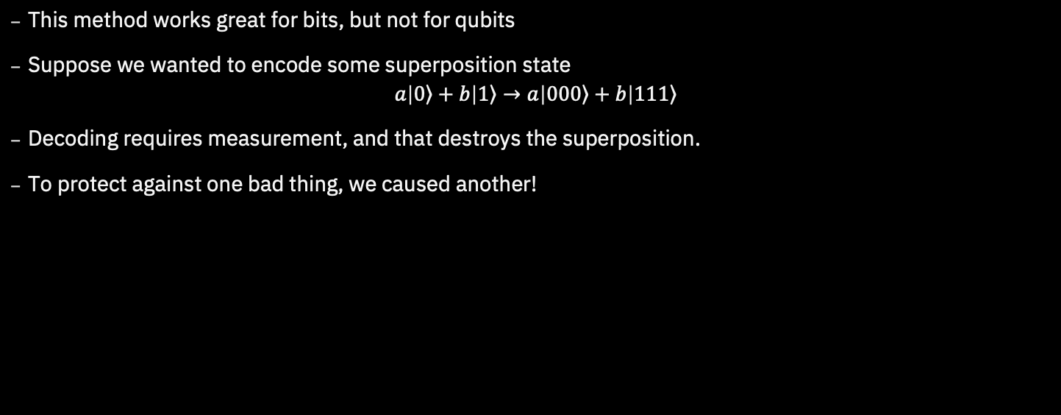
Quantum Computation
  This method works great for bits, but not for qubits
  Suppose we wanted to encode some superposition state
  $a\left|\left.0\right\rangle +b\right|\left.1\right\rangle →a\left|\left.000\right\rangle +b\right|\left.111\right\rangle$
  Decoding requires measurement, and that destroys the superposition.
  To protect against one bad thing, we caused another!

Slide 14
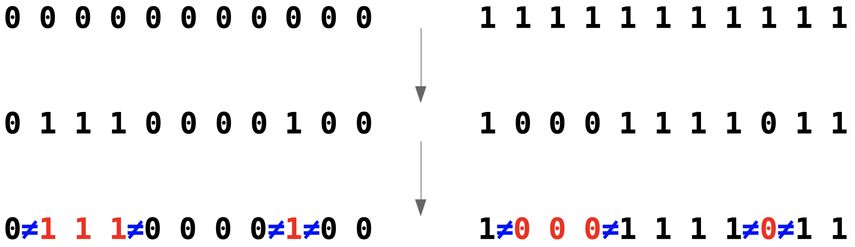
Quantum Computation
  To solve this, we need to be more careful with our measurements.
  We do need to measure, to get information about errors. But we must avoid learning about the encoded information
  For this, note that we don’t actually need the bit values. We only need to know which ones have a different value to the rest.

Slide 15
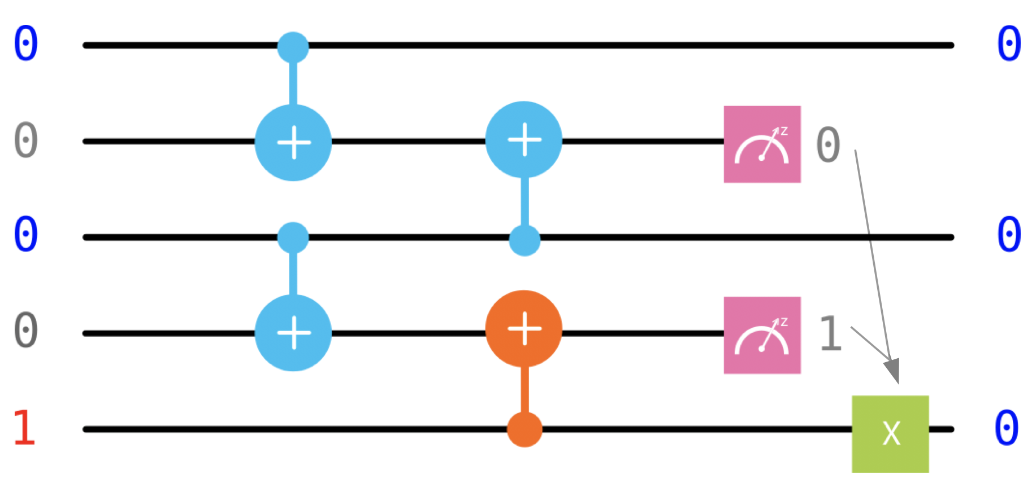
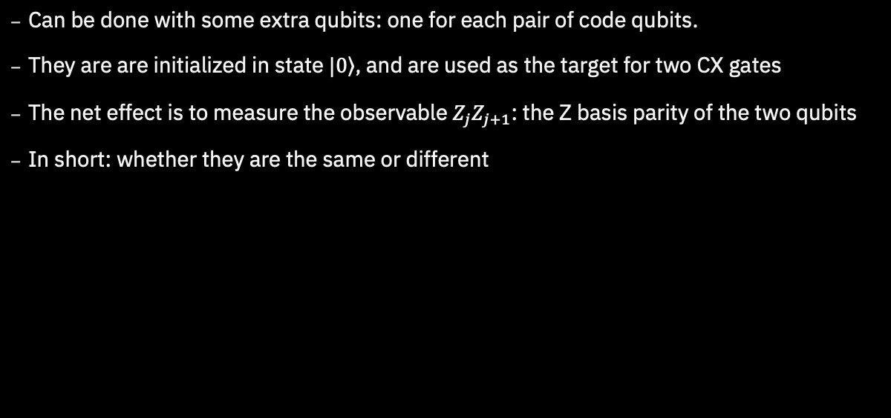
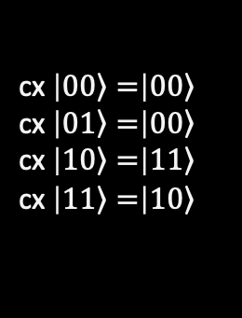
Quantum Repetition Code
  Can be done with some extra qubits: one for each pair of code qubits.
  They are are initialized in state $\left.|0\right\rangle$, and are used as the target for two CX gates
  The net effect is to measure the observable $Z_{j}Z_{j+1}$: the Z basis parity of the two qubits
  In short: whether they are the same or different
cx $\left|\left.00\right\rangle =\right|\left.00\right\rangle$
cx $\left|\left.01\right\rangle =\right|\left.00\right\rangle$
cx $\left|\left.10\right\rangle =\right|\left.11\right\rangle$
cx $\left|\left.11\right\rangle =\right|\left.10\right\rangle$

Slide 16
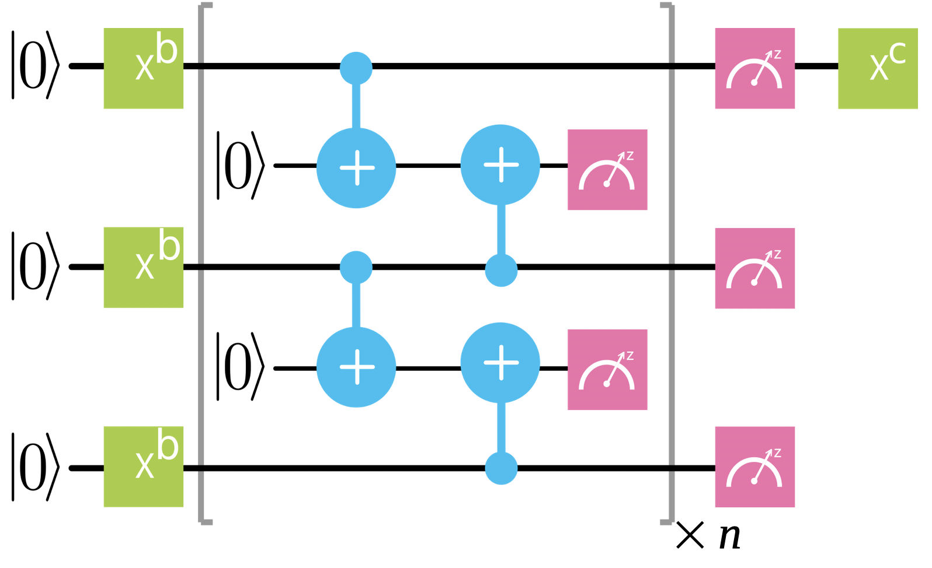
Quantum Repetition Code
  The parity measurements are repeated over the course of the computation
  The results are used to identify where errors likely occurred and how to remove their effects
  This is done by means of a classical algorithm: a decoding algorithm
  With this we can protect against bit flip errors
  for an arbitrarily long time

Slide 17
Syndrome Measurement
  This measurement is a syndrome measurement
  The result is known as the syndrome
  All codes have them
  They are ways to check that all the qubits
  are doing what they should be
  Their form changes from code to code,
  but their job is always the same
  They provide the clues that allow us
  to detect and correct errors

Slide 18
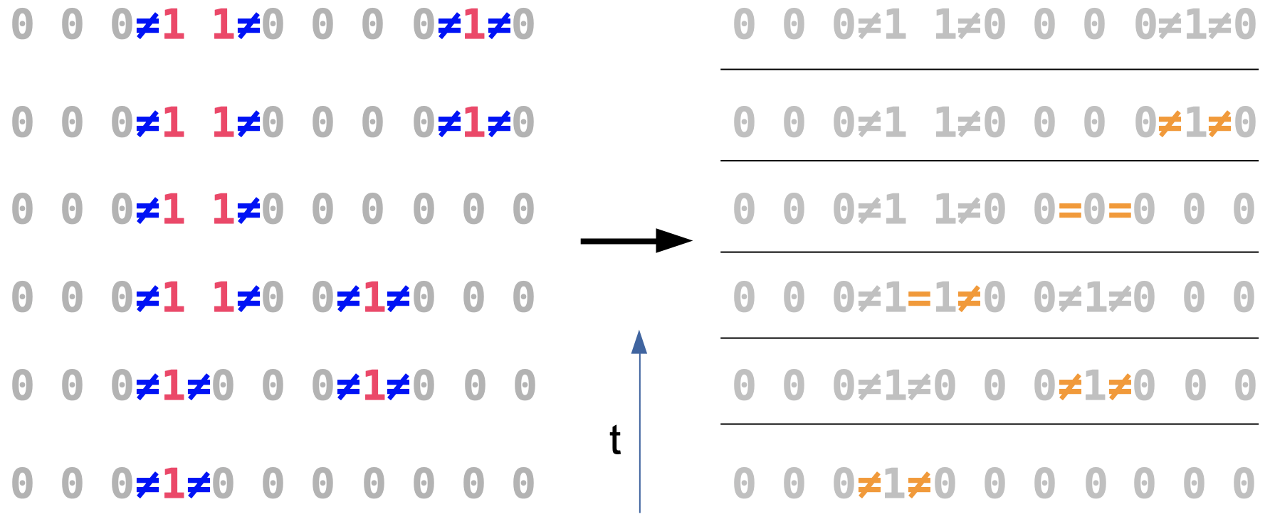
Decoding
  Start with an unrealistically simple case: errors between parity measurements only (not during)
  Focus on identifying errors for now (not correcting)
  Look for changes between rounds
  Errors create pairs of ‘defects’. Majority voting can be used to find a minimal pairing.

Slide 19
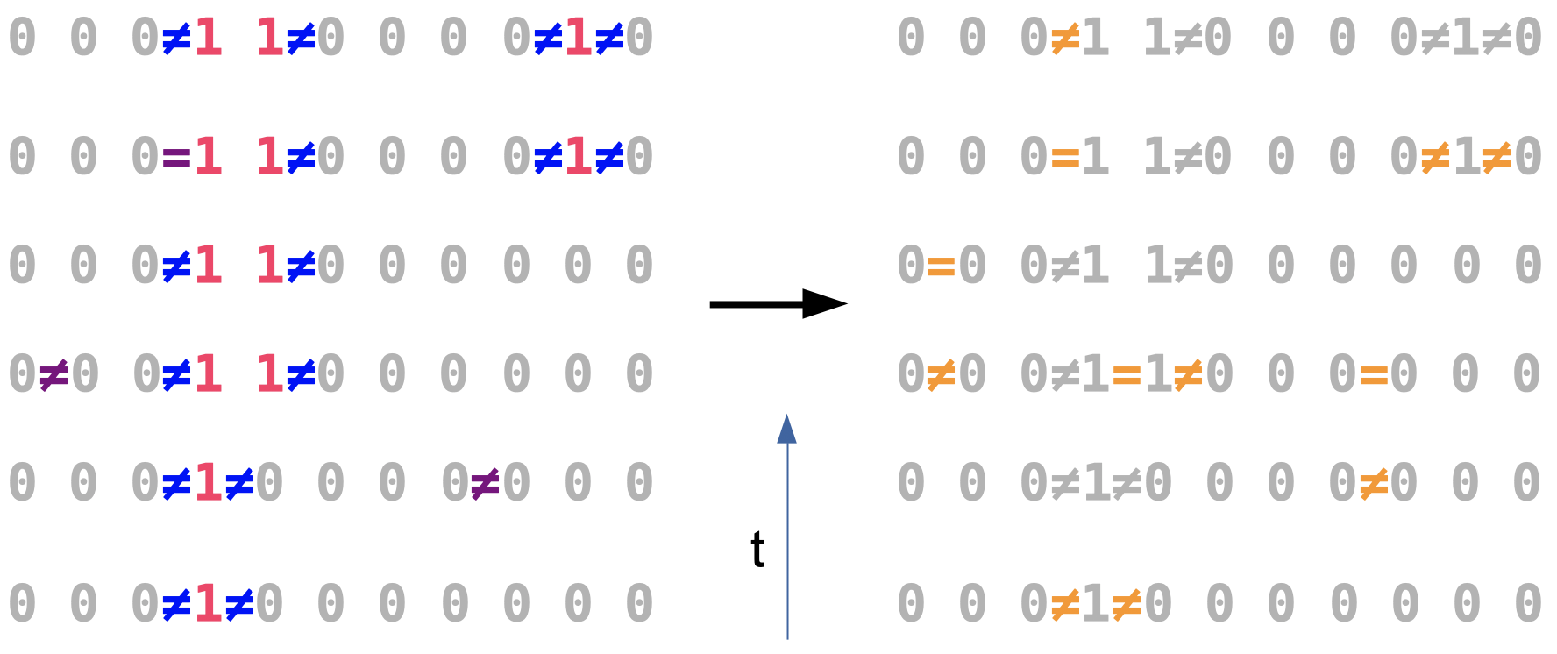
Decoding
  Next, a simple model of noise in the measurements: they randomly lie
  Again, look for changes between rounds
  Bit flips create defects with space-like separation, measurement errors with time-like
  Pairing is now a 2D problem, majority voting won’t work

Slide 20
Decoding
  There are many ways to do this, all with pros and cons
  One of the best is to think of the problem as a graph
    Defects are nodes
    The number of errors required to link them are weighted edges
  A likely set of errors corresponds to the ‘minimum weight perfect matching’ of the graph
  Efficiently computable using the ‘Blossom’ algorithm

Slide 21
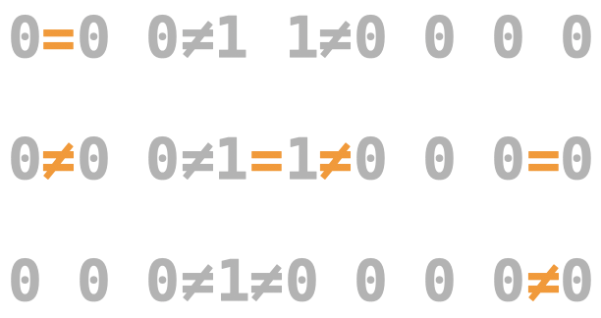
Decoding
  Here it is in action for a portion of the example from earlier

Slide 22
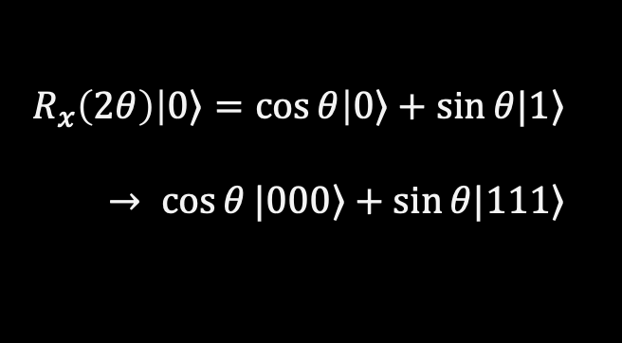
Logical Operations
  If we wanted to manipulate the logical qubit, how could we do it?
  This requires a logical operation, made up of many
  physical operations
  The logical X gate is easy for the repetition code
    Do physical X gates on code qubits
    Code corrects imperfections
  An Rx gate essentially needs you to take the
  code apart and put it back together again
    Not protected while unencoded
$$R_{x}\left(2θ\right)\left|\left.0\right\rangle =\cos{θ}\right|\left.0\right\rangle +\sin{θ|\left.1\right\rangle }$$
$→ \cos{θ}|\left.000\right\rangle +\sin{θ|\left.111\right\rangle }$

Slide 23
Quantum Repetition Code
  The limited set of fault-tolerant logical gates is a major problem with the repetition code
  But it is not the only one!
  The code only allows us to detect and correct bit fips, and only bit flips
  Though we made sure that it doesn’t cause superpositions to collapse, it doesn’t protect them either
  The repetition code is a good first example of quantum error correction,
  but it cannot give us fault-tolerant quantum computation

Slide 24
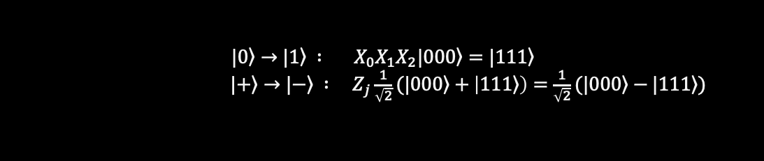
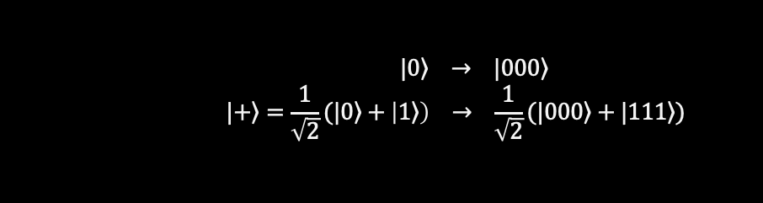
Towards a good quantum code
  The problem with the repetition code is that it treats z basis states very different to x and y basis states
  Example 1: z basis states are product states, the others are entangled
  Example 2: Distinguishing encoded z basis requires a single qubit measurement, distinguishing x basis states requires d
  Example 3: Flipping between z basis states requires d gates, but the x basis only takes one
  It is not good when things are too easy, because they are easy for errors too!
$$|\left.0\right\rangle → |\left.000\right\rangle$$
$$|\left.+\right\rangle =\frac{1}{\sqrt{2}}(|\left.0\right\rangle +\left|\left.1\right\rangle \right) → \frac{1}{\sqrt{2}}(|\left.000\right\rangle +|\left.111\right\rangle )$$
$${|\left.0\right\rangle →|\left.1\right\rangle : X}_{0}X_{1}X_{2}|\left.000\right\rangle =|\left.111\right\rangle$$
${|\left.+\right\rangle →|\left.−\right\rangle : Z}_{j}\frac{1}{\sqrt{2}}(|\left.000\right\rangle +\left|\left.111\right\rangle \right)=\frac{1}{\sqrt{2}}(|\left.000\right\rangle −|\left.111\right\rangle )$

Slide 25
How good is QEC today?
  We need to at least test the standard methodology
    Encode bit values
    Detect errors using stabilizer measurements
    Correct during decoding
  Simplest way is using the repetition code
    Needs at least 5 qubits
    Very flexible on connectivity
    Detects and corrects bit flips

Slide 26
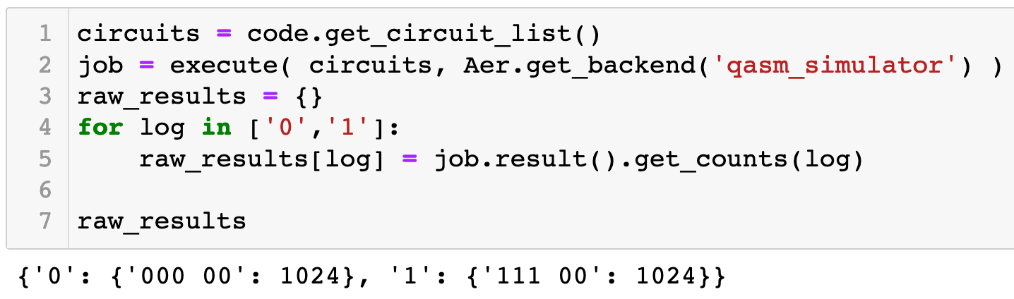
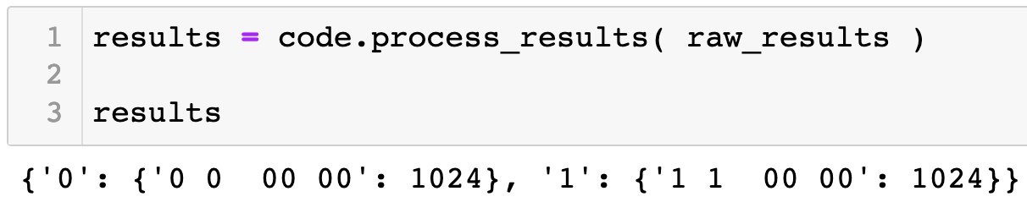
topological_codes in Qiskit Ignis
  Two circuits per code that need to be run
  Required output is the counts dictionary
  The bit strings are transformed into a more QEC friendly form

Slide 27
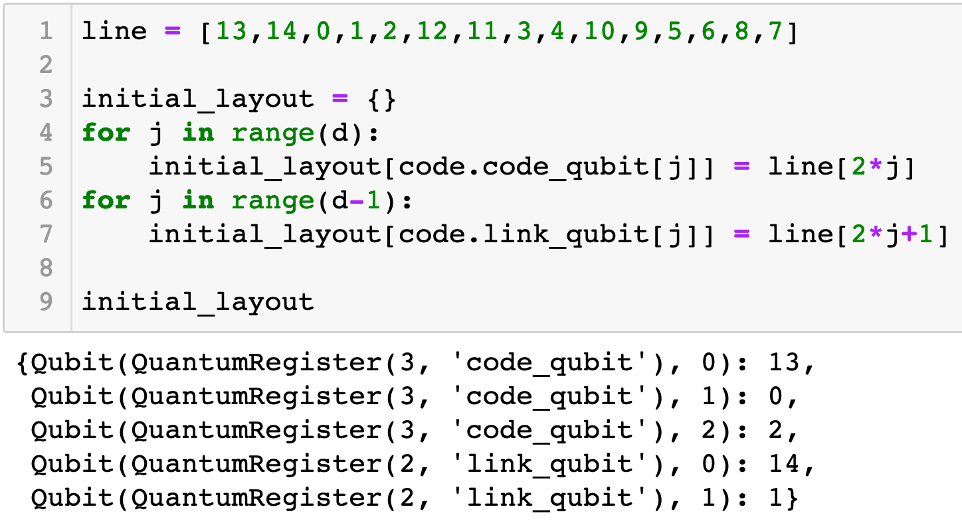
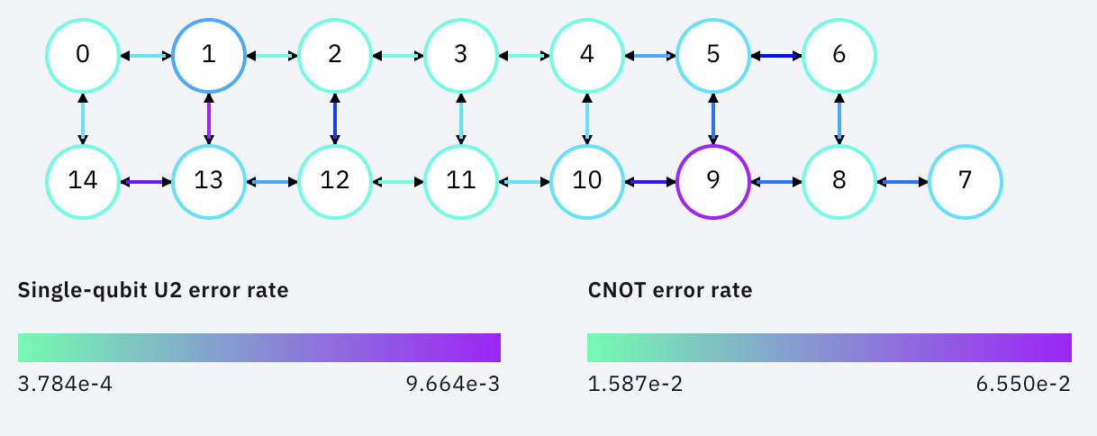
topological_codes in Qiskit Ignis
  Important to know which qubits are being used
  Remapping also remaps noise, making uncorrectable errors

Slide 28
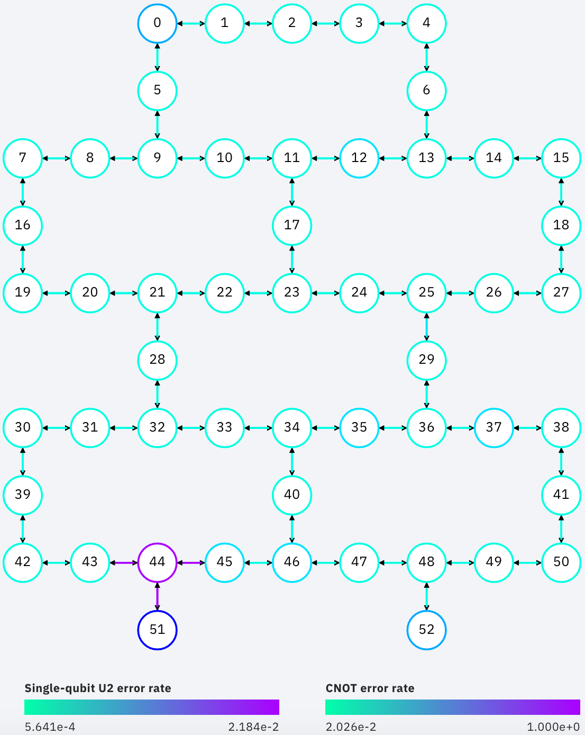
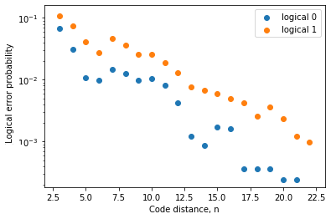
43 qubit results
  James R. Wootton 2020 Quantum Sci. Technol. doi.org/10.1088/2058-9565/aba038
  Run on rochester for d=3 to d=23 codes (up to 43 qubits)
  Results consistent with exponential decay

